Slide 1
Introduction To Machine Learning
Amit Kumar Manjhi

Slide 2
Agenda
What is Machine Learning?
Key Concepts in Machine Learning
How would you apply Machine Learning to solve your problem?
Python Tools For Machine Learning
An Example of Machine Learning Problem

Slide 3
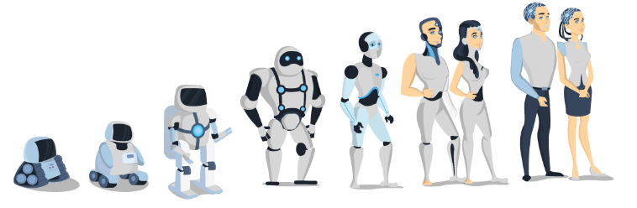
What Is Machine Learning?
Machine Learning is the science (and art) of programming computers so they can learn from data.
General Definition:
Machine Learning is the field of study that gives computers the ability to learn without being explicitly programmed. [Arthur Samuel, 1959 ]
Applied Machine Learning: Here applied means how to interpret the machine learning algorithms at a high level.

Slide 4
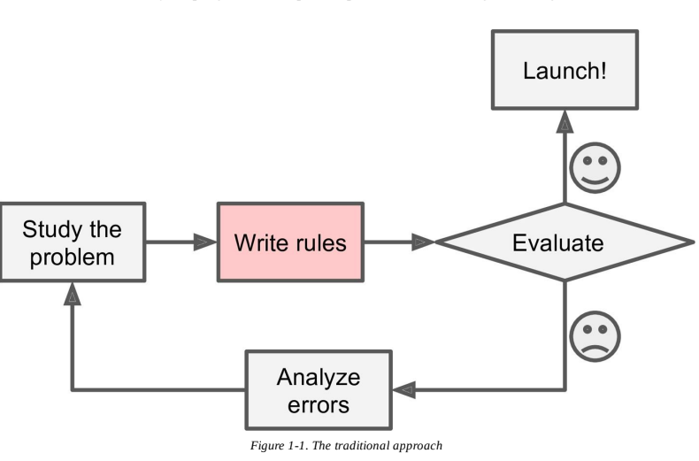
Why Machine Learning?
Consider how you would write a spam filter using traditional programming techniques

Slide 5
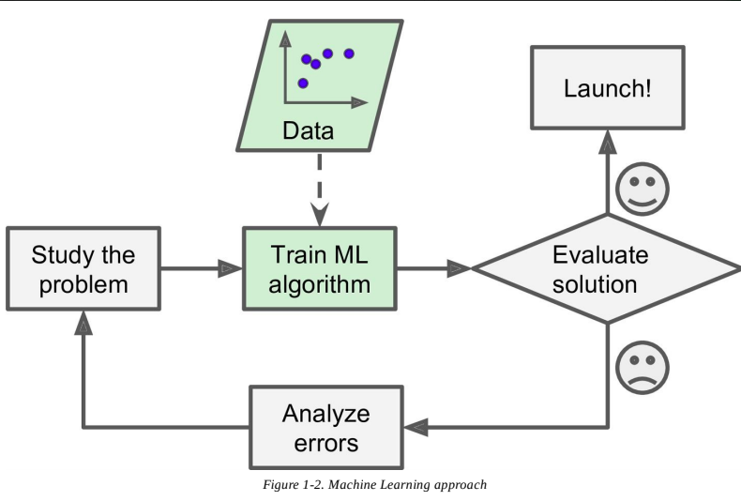
Machine Learning Approach

Slide 6
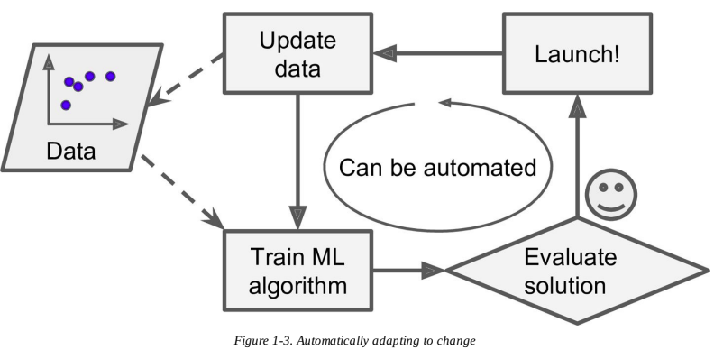
Machine Learning Approach

Slide 7
To Summarize, Machine Learning is Great For:
Problems for which existing solutions require a lot of hand-tuning or long lists of rules: one Machine Learning algorithm can often simplify code and perform better.
Complex problems for which there is no good solution at all using a traditional approach: the best Machine Learning techniques can find a solution.
Fluctuating environments: a Machine Learning system can adapt to new data.

Slide 8
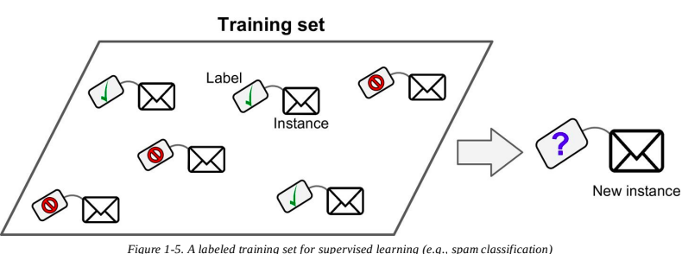
Key Concept In Machine Learning
Machine Learning systems can be classified according to the amount and type of supervision they get during training.
Supervised learning (Train Me!) : Once the model gets trained it can start making a prediction or decision when new data is given to it.
Supervised Algorithms:
k-Nearest Neighbors, Linear Regression ,Logistic Regression ,Support Vector Machines (SVMs) ,Decision Trees and Random Forests

Slide 9
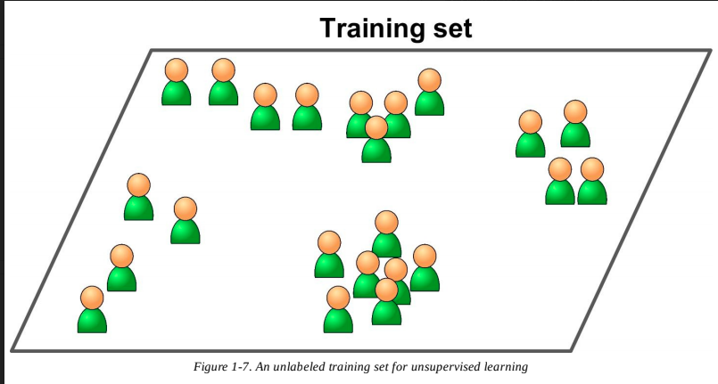
Unsupervised Learning
Unsupervised Learning – I am self sufficient in learning.
Unsupervised Algorithms:
Clustering k-Means ,Hierarchical Cluster Analysis (HCA) ,Principal Component Analysis (PCA)

Slide 10
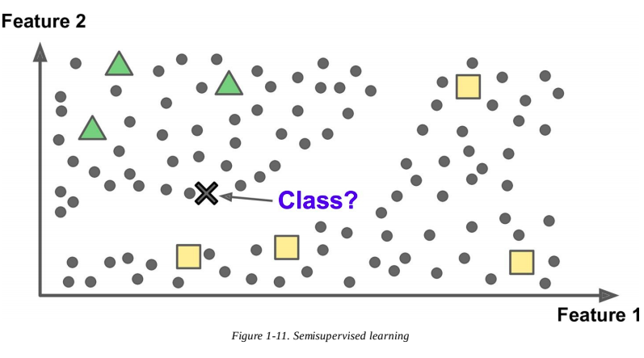
Semisupervised Learning
Some algorithms can deal with partially labeled training data, usually a lot of unlabeled data and a little bit of labeled data. This is called semisupervised learning
Most semisupervised learning algorithms are combinations of unsupervised and supervised algorithms. For example, deep belief networks (DBNs)

Slide 11
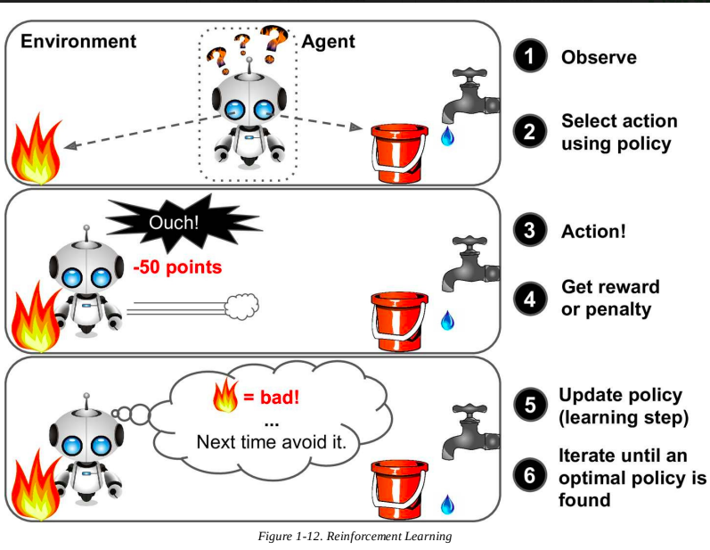
Reinforcement learning – my life my rules! (Hit & trial)
The learning system, called an agent in this context, can observe the environment, select and perform actions, and get rewards in return.
For example, many robots implement Reinforcement Learning algorithms to learn how to walk. DeepMind’s AlphaGo program is also a good example of Reinforcement Learning

Slide 12
How would you apply machine learning to solve your problem?
There are three basic steps:
Representation: How to represent learning problems in terms of something that a computer can understand. In this step, you have to also decide what kind of algorithm to apply to selected data.
Evaluation: In this step, we can calculate the quality and accuracy score for the prediction coming out from the machine learning algorithm typically called classifier.
Optimization: In this step, we need to search for an optimal classifier that gives the best outcome for the selected problem.

Slide 13
Python Tools For Python
scikit-learn: scikit learn is the most widely used Python library for machine learning. It is an open-source project
SciPy: sciPy is a python library that supports data manipulation and commonly used in scientific computing which includes statistical distribution, optimization of functions, linear algebra, and variety of specialized mathematical functions.
Numpy: Numpy is a scientific computing python library that contains the support for fundamentals data structure used by scikit-learn.such as multidimensional-array.
Pandas: Pandas is a python library for data manipulation and analysis. It supports data structures like DataFrame.
matplotlib: matplotlib is widely used python 2D plotting library that produces high-quality figures in a variety of formats

Slide 14
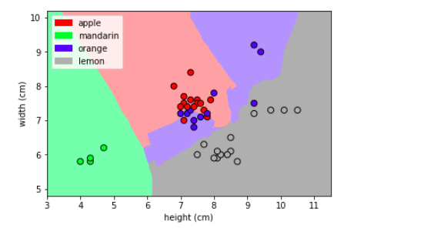
An example of machine learning problem

Slide 15
References
https://www.edureka.co/blog/what-is-machine-learning/
https://www.coursera.org/learn/python-machine-learning
https://www.oreilly.com/library/view/hands-on-machine-learning/9781492032632/

